Slide 1

Group 24 B

Slide 2
Demonstration of the work
Introduction
Review
Design/implementation
Conclusion

Slide 3
Introduction
What is our project about:
We created a website. This website is a financial website.
Aim/object:
The aim of this project is to help the people manage their finance with the help of this website by managing their income and outcome and showing it as a graph or a diagram.

Slide 4
Review
Similar financial websites:
https://www.morganstanley.com/.
https://www.personalcapital.com/

Slide 5
Personal Capital financial Site
Features that they offer:
1)Wealth management
.it offers the customer something called private client.
.Personal strategy: the website helps the customers to make their own strategies
.they can teach the customer how to invest using the investment methodology.

Slide 6
Personal Capital financial Site
2)Financial Tools:
. Plans for retirement and plans for savings: it helps the customer to make a plan for retirement and manage it and also they have ready plans for saving and they can help the customer to choose the plan that suits him.

Slide 7
Morgan Stanley site
Features:
Wealth Management:
. It has been explained in the previous slide( same feature).
2) Research:they offer timely, integrated analysis of companies, sectors, markets and economies, helping clients with their most critical decisions

Slide 8
Morgan Stanley site
3)Investment Management:
. They deliver active investment strategies across public and private markets and custom solutions to institutional and individual investors.

Slide 9
Features included in the project
Features:
Our website is simple and basic to be used one of its famous features is to manage the client income and outcome.
It displays the customer income and outcome on graphs
It displays the customer income and outcome on a diagram

Slide 10
Features can be included in the site
New ideas:
Spending limit for the customers to help them manage their spending during the month or even annually
Suitable investing for offer scalable investment products, foster innovative solutions and provide actionable insights across sustainability issues.

Slide 11
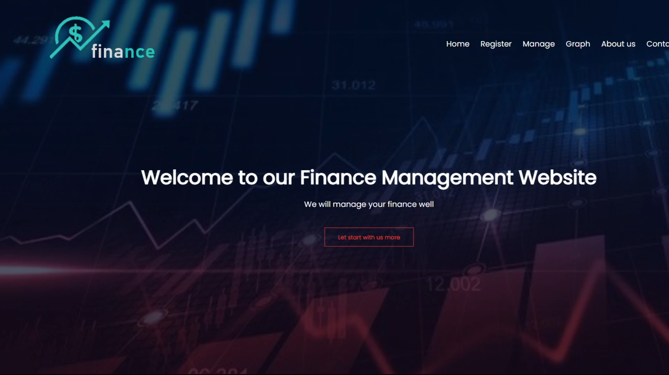
Design & Implementation

Slide 12
Conclusion
Our website is a financial website that helps the cutomers to manage their monthly income and outcome and gives them the balance.
The useful features in out website is that the customer can have a better look at his spending and know his better how his income and outcome going by looking at the diagram and the graphs that helps him to know

Slide 13
Conclusion
The website can be improved by adding some new features like : Spending limit, Suitable investing.

